Slide 1
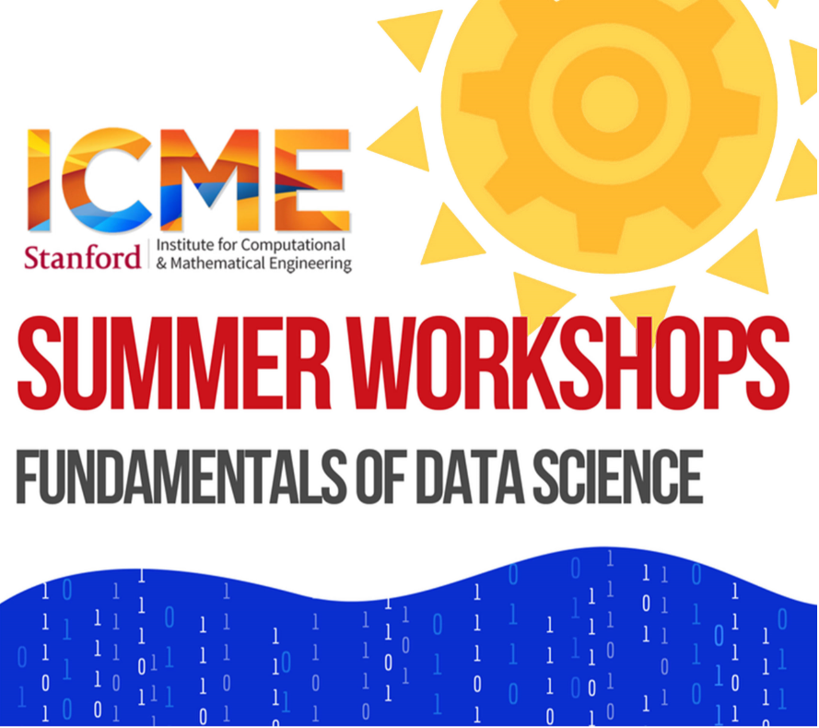
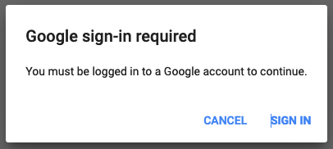


Welcome to Introduction to Python!
(We start at 9am)
Python on Google Colab
shorturl.at/gAJX5
Interactive polls (no account needed)
pollev.com/andreassantucci359
Slides
https://bit.ly/3kYEv1s
No Colab? Download Anaconda and code from
www.anaconda.com/products/individual
www.stanford.edu/~lcambier/pc/code_data.zip
Open Python.ipynb in Jupyter (Anaconda Navigator → Jupyter → Select file)
1.
Open link in web browser
2.
Ready !

Slide 2


Introduction to Python
Léopold Cambier
lcambier@stanford.edu
ICME Summer Workshops
Fundamentals of Data Science
August 18, 2020

Slide 3


First and Foremost
Workshop is recorded (audio & video)
Office-hours (1pm-2pm) will not be recorded.
If you are OK, turn on your camera :-)
Ask questions in chat.
Ryan our awesome TA is answering.
Stay muted unless you are actively talking
Covid edition

Slide 4
Some questions for you first!
PollEv.com/lc928
Mandatory to participate :-)
Laptop or phone (keep the tab open for later)
No account needed, anonymous
The more the better.

Slide 5
Some info about me
5th year PhD in ICME
Numerical linear algebra (very big sparse “Ax=b”)
Parallel computing (big computers)

Slide 6
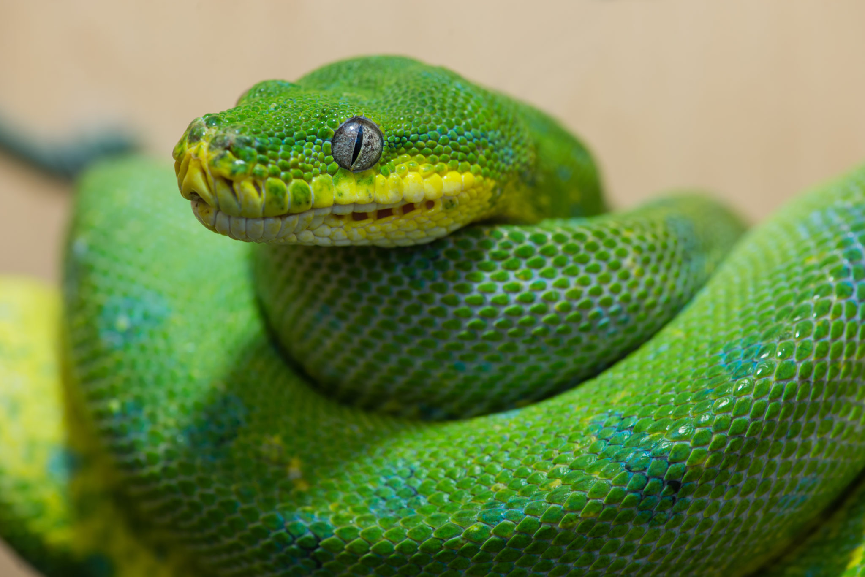
“Python” you said ?

Slide 7

“Python” you said ?
Monty Python
and the Holy Grail
Notes:
Comes from Monty Python’s Flying Circus

Slide 8
Python
A very popular programming language
Web applications
Scientific computing
Data science and machine learning
General purpose applications

Slide 9
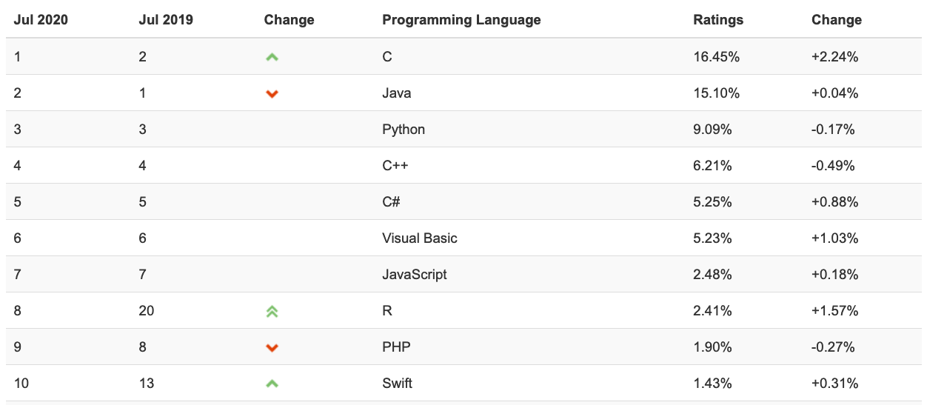
Python www.tiobe.com

Slide 10
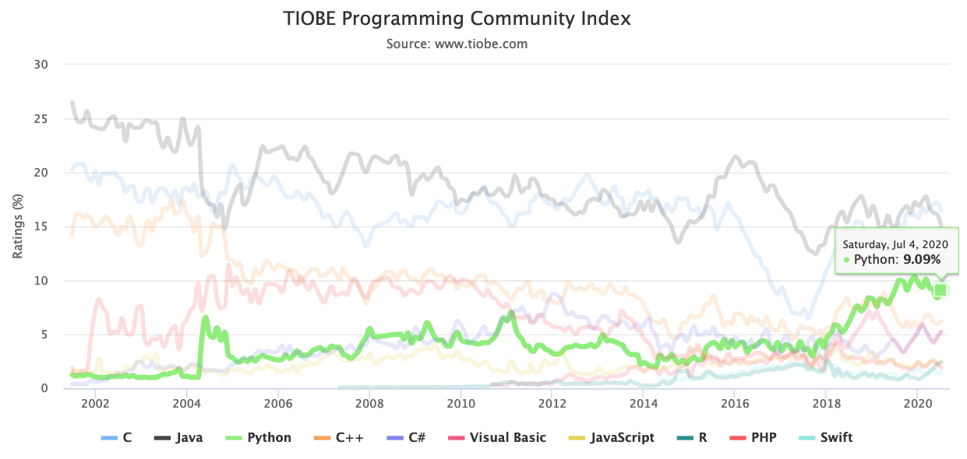
Python www.tiobe.com

Slide 11
The class
9:00-10:30 | Basic Python
10:45-12:00
1:00-2:00 | Q&A (optional)
2:00-3:15 | Numpy, Pandas, Scikit-learn (more applied)
3:30-4:45
Python
Variables, control-flow, containers, I/O
Functions, iterables
(Maybe) References, modules
Numpy + Matplotlib
Pandas
Scikit-learn

Slide 12
The class
We will go through code together.
Ask questions in the chat
Many exercises.
Goal:
Good enough basic Python knowledge to explore on your own.
Exposure to various tools used in science. Won’t be an expert.

Slide 13
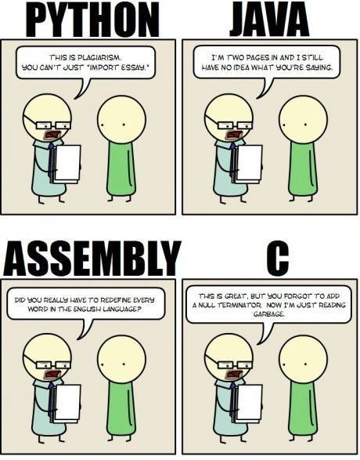
Python
This is plagiarism. You can’t just “import essay.”
I’m two pages in and I still have no idea what you’re saying.
High-level
Portable
Interpreted
Extensible
Object-oriented
Dynamically typed
Garbage collected
Did you really have to redefine every word in the English language?
This is great, but you forgot to add a null terminator. Now I’m just reading garbage.

Slide 14
Python 2 vs Python 3
Really no reasons to learn Python 2 in 2020 :-)

Slide 15
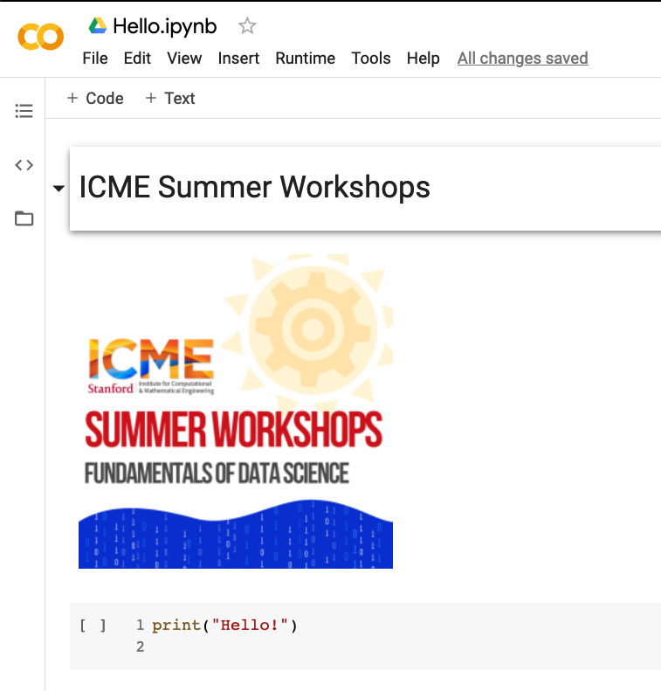
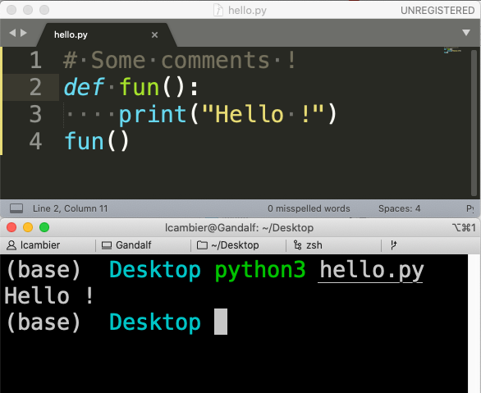
How to use Python ?
Scripts and Python text files
(in a text editor, offline, usually)
Notebooks (text + viz + code)
(in web browser, online or offline)
Notes:
Python scripts
Standard way
Jupyter notebooks
Good for interactive use
Good for teaching
Can use Google Colab
Not good for large complex programs

Slide 16
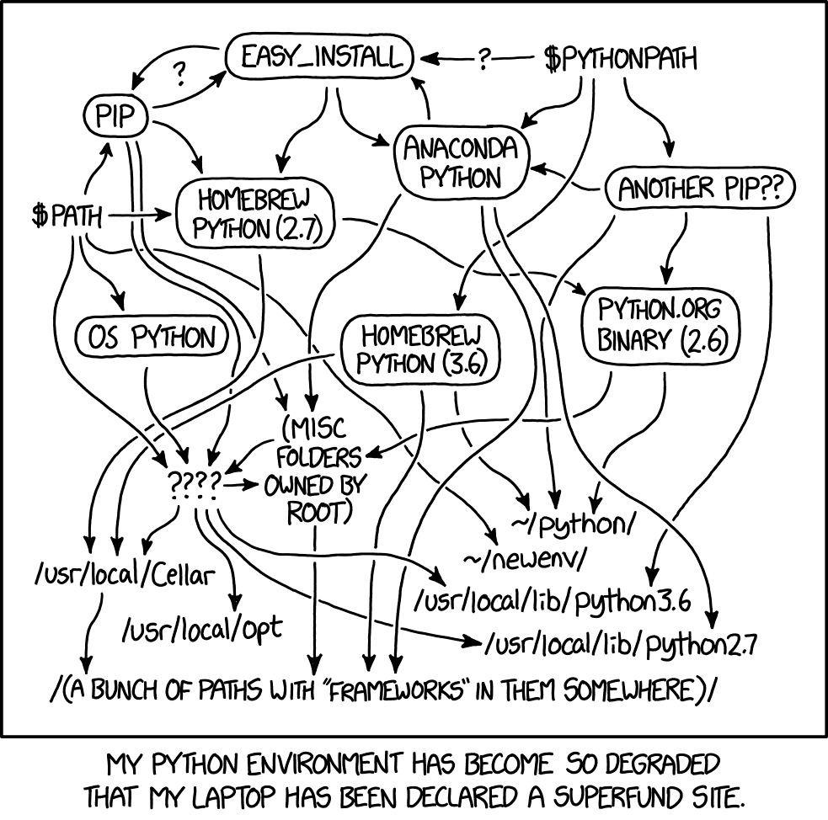
Running on your laptop
Download Anaconda
https://www.anaconda.com/products/individual
Comes with all you need
Many modules preinstalled
Can use for scripts from terminal
Can use for Jupyter notebooks from browser

Slide 17
Let’s open the first Notebook!

Slide 18
Strings indexing
s = “abcdefgh”
0 | 1 | 2 | 3 | 4 | 5 | 6 | 7
a | b | c | d | e | f | g | h
-8 | -7 | -6 | -5 | -4 | -3 | -2 | -1

Slide 19
Dictionaries

Slide 20
Everything is a reference (1)
a = 2
a = 3

Slide 21
Everything is a reference (2)
a = "Stanford"
b = a
a = "ICME"
print(b)

Slide 22
Everything is a reference (3)
a = [1, 2, 3]
b = a
a[0] = "ICME"
print(b)

Slide 23
Everything is a reference (4)
a = [1, 2]
t = (a, 1, "String")
a[0] = [3, 4]
print(t)

Slide 24
Everything is a reference (5)
def fun(x):
# same as x = a
# ...
a = # Something
fun(a)

Slide 25
Quizzes !
PollEv.com/lc928

Slide 26
Welcome back to Introduction to Python!
Numpy
bit.ly/3h844uz
Pandas
bit.ly/3kYEVoy
Sklearn
bit.ly/3280RF8
No Colab? Download code from
www.stanford.edu/~lcambier/pc/code_data.zip
Open Python.ipynb in Jupyter (Anaconda Navigator → Jupyter → Select file)
Open link in web browser
Ready !
Notes:
To mention
Outlets
Evacuation
Seats
Laptops pairing
Heat
Noise
Time

Slide 27

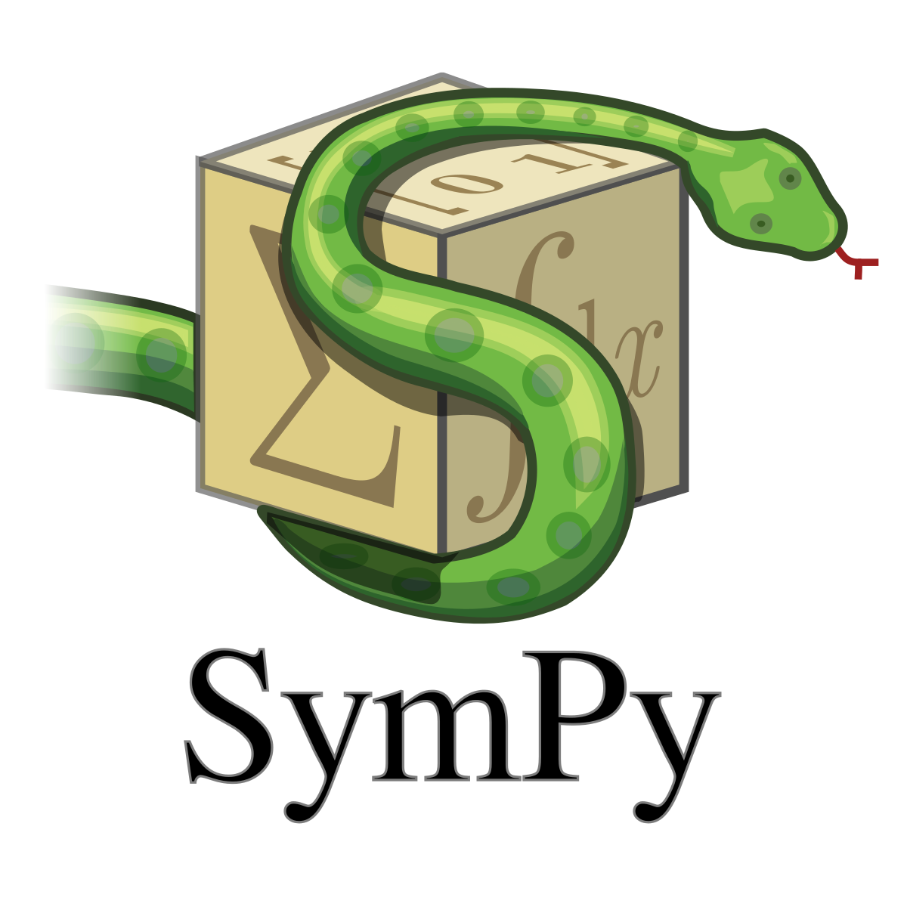
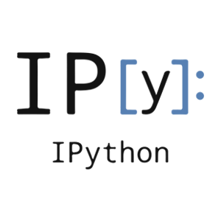
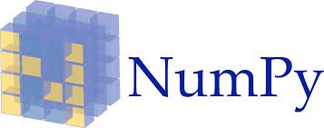



SciPy
An ecosystem for Scientific Computing and Data science in Python
Includes many packages

Slide 28
Numpy: arrays
1-D array
2-D array
3+-D array

Slide 29
Reshaping
5 x 4
2 x 10
.reshape((2, 10)) =

Slide 30
Broadcasting
3 x 2-array
3 x 2-array
3 x 2-array
2-array (vector)
a | b
a | b
a | b
+
=
+
a | b

Slide 31
Axis
axis=1
axis=0
a.mean(axis=0)

Slide 32
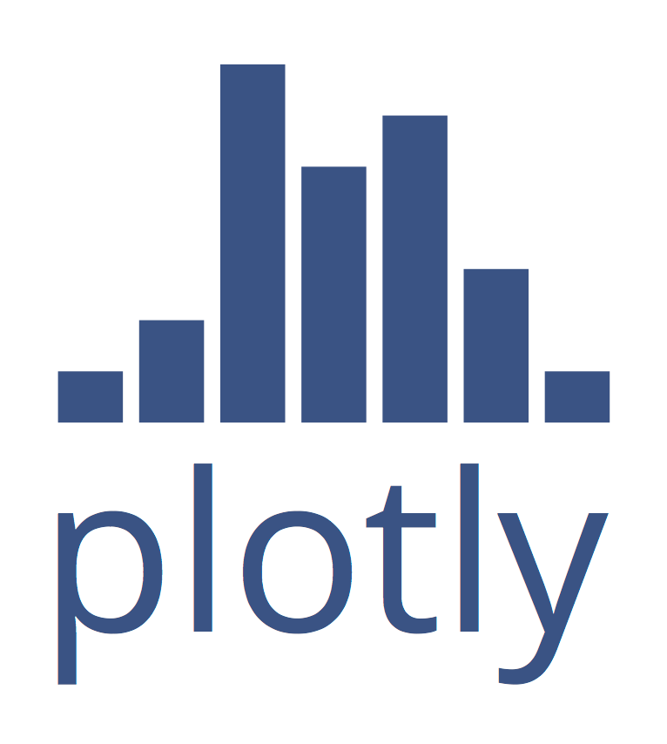
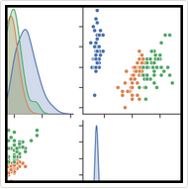
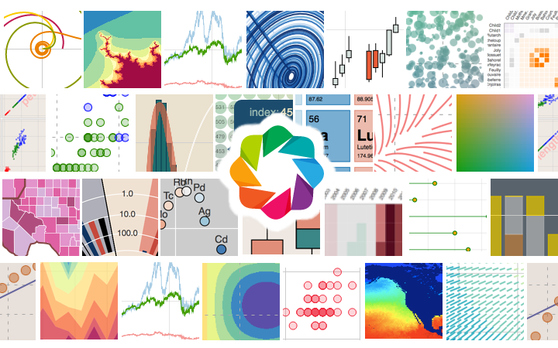
Plotting Ecosystem
Seaborn
Bokeh

Slide 33
Scipy
Linear Algebra (scipy.linalg)
Optimization (scipy.optimize)
Statistics (scipy.stats)
Many more

Slide 34
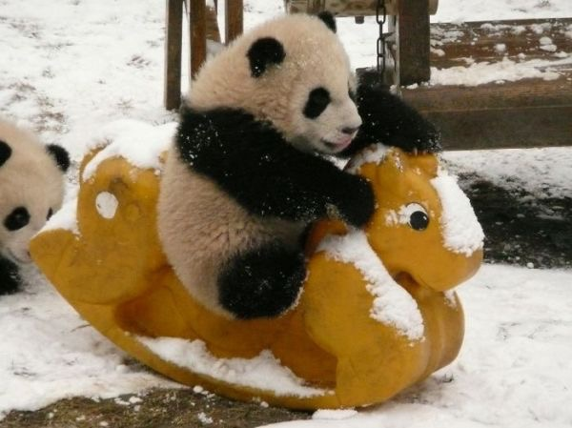
Pandas
Open-source, high-performances & easy-to-use data structures
DataFrame objects
Aggregation, grouping, reductions, statistics, etc.
Powerful dates support
All kinds of read/write functions (csv, HDF5, etc.)

Slide 35
Accessing a DataFrame
By Labels
df[column] # Get one column
df[rows] # Get multiple rows
df.loc[cols,rows] # End-points INCLUDED
By position
df.iloc[cols,rows] # End-points NOT INCLUDED w/ `:`

Slide 36
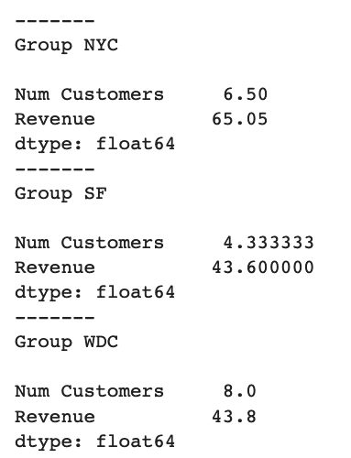
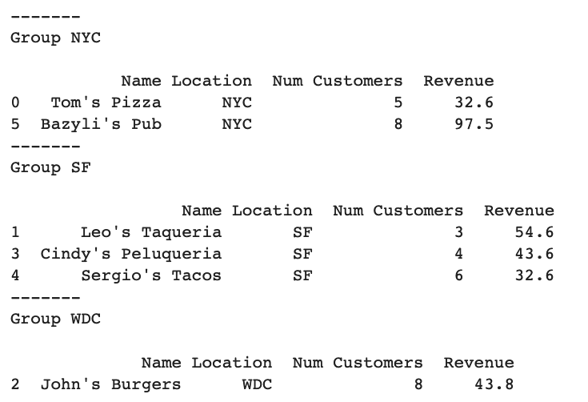
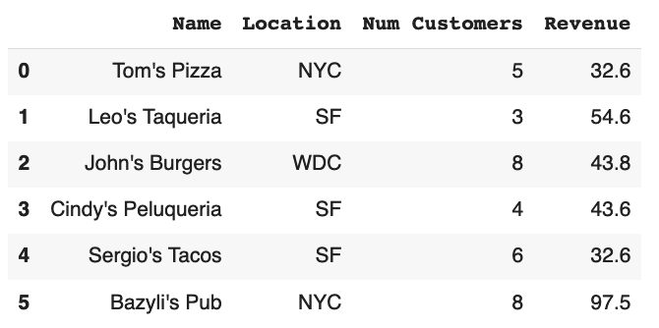
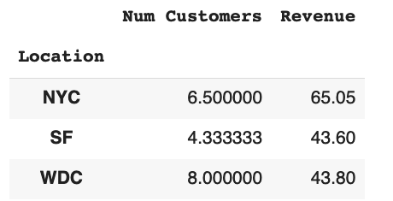
Groupby
Transform
Split
df.groupby('Location’).mean()
Combine

Slide 37
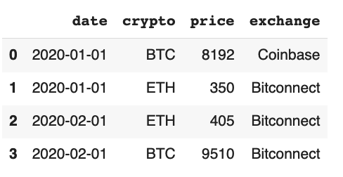
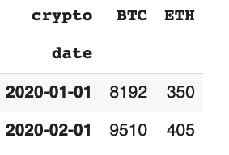
Pivot
df.pivot(index=’date’,columns=’crypto’,values=’price’)

Slide 38
Scikit-learn
A package for machine learning
Supervised learning
Classification
Regression
Unsupervised

Slide 39
Scikit-learn
A typical supervised learning problem
Given a dataset
S = {x_{i}, y_{i}}
Learns a function (mapping)
y = F(x)
Lots of kinds of models !
https://scikit-learn.org/stable/supervised_learning.html
https://scikit-learn.org/stable/unsupervised_learning.html
https://scikit-learn.org/stable/model_selection.html
… https://scikit-learn.org/stable/user_guide.html

Slide 40
Scikit-learn
# Pick a model
from sklearn import model
m = model.somemodel
# Train
m.fit(X_train, y_train)
# Predict
y_pred = m.predict(X_pred)

Slide 41

Recap
import antigravity
# Try it on your laptop,
# In a Python interpreter
(https://xkcd.com/353/)

Slide 42
More easter eggs
Try those in a Python interpreter
>> from __future__ import braces
>> import this
>> import __hello__

Slide 43
Recap: What did we learn?
Basic Python
Numpy for arrays
Scipy for linear algebra, optimization, statistics
Matplotlib for simple plotting
Pandas for data analytics
Scikit-learn for machine learning

Slide 44
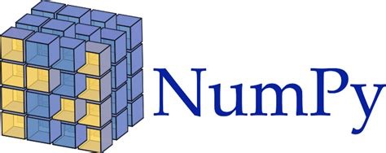


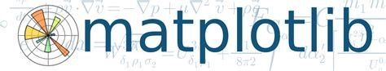


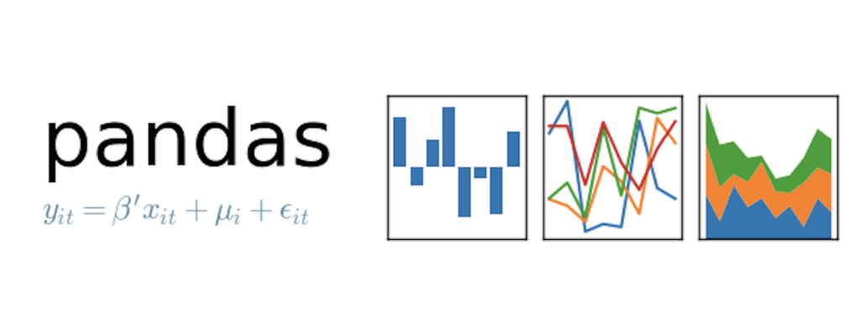



The Python Ecosystem (a tiny subset)
Seaborn
And many, many more (mpi4py, numba, joblib, …)

Slide 45
References
Python
Google & Stackoverflow
https://docs.python.org/3/
https://developers.google.com/edu/python/
https://www.learnpython.org
http://www.practicepython.org/
https://dabeaz-course.github.io/practical-python/Notes/Contents.html
Numpy & Scipy
https://docs.scipy.org/doc/numpy/user/quickstart.html
Pandas
https://pandas.pydata.org/pandas-docs/stable/10min.html
https://github.com/jvns/pandas-cookbook
Scikit-learn
http://scikit-learn.org/stable/tutorial/basic/tutorial.html

Slide 46
At Stanford
CME211
Software Development for Scientists and Engineers
CS106AP
Programming Methodology in Python
CS102, CS131, CS230, CS231N, CS375: Machine Learning (using Python)
CME302: Numerical Linear Algebra (using Python)
Best class at Stanford! Really!

Slide 47
Any question after the class?
lcambier@stanford.edu
-> Stanford Continued Education

